Slide 1






PDS
Computer Vision
QoS : Network Performance
@ P. Siagian
https://github.com/siagianp
https://www.youtube.com/@AmelOline/videos
https://github.com/amelcharolinesgn2/IoT_simulator-mqtt-NodeRed
github.com/amelcharolinesgn2/ANJAR

Slide 2
Network Performance
Bandwidth and Throughput
Sources/Definitions of latency, jitter and loss

Slide 3
Network properties
Latency
Network Delays – fixed and variable
Jitter
Variation in Delay: causes and impact
Throughput
Bandwidth/Capacity: actual/available
Losses
Packets drops, link and device failures, loops

Slide 4
Latency & Jitter

Slide 5
Reality Check
GOLDEN RULE
Information propagation IS NOT instantaneous
It is not possible for EVERY user to share the
EXACT same state at EVERY instance

Slide 6
Impact on the Shared Experience
Host A
Host C
Host B
Notes:
Illustration of Consistency issues by having three different hosts illustrating casual consistency with differences in the updates of an avatar. The host B is the owner of the avatar. In host A, there is a slight delay but then the avatar synchronizes by apparently moving faster than in Host B. The same concerning Host C, where the delay is even greater than in A.

Slide 7
Overview of the Challenge
Senses
Mental Model
Human Brain
Devices
Local Host
Access
Network
Muscles
Human
System
Network
Internal Processing
Local Processing
Network Processing
The total processing time must not exceed the interactive threshold which is determined by Gameplay

Slide 8

Latency and Jitter : Single Host
Application
System Model
Input
Simulation
Rendering
1
2
3

Slide 9
Latency and Jitter : Networked Host
Application
System Model
Input
Simulation
Rendering
1
Network
2
Link
4
5
Physical
Internet
3

Slide 10
Latency and Jitter : Client and Server
Application
System Model
Input
Simulation
Rendering
1
Network
2
Link
5
6
Physical
Internet
3
4
Server Application
Simulation

Slide 11
Latency and Jitter : Single Host
Application
Device
Input
Simulation
Rendering
Display
Path A
Notes:
Figure 10.1 (Top)

Slide 12
Latency and Jitter : Client and Server
Client Application
Device
Input
Simulation
Rendering
Display
Network
Path D
Link
Physical
Path C
Path B
Physical
Link
Network
Server Application
Simulation
Notes:
Figure 10.1 (Bottom)

Slide 13
Latency : Network Perspective
Input Queues
Output Queues
Routing Table
Handler

Slide 14
Latency : Network Perspective
Input Queues
Output Queues
Latency
Latency
Routing Table
Latency
Handler
Notes:
Sources of latency:
Input queue : Queuing latency
Processing and error bit checking
Output queue : Queuing latency

Slide 15
Network Delay : 4 Components
Router
Sender
Transmission
Delay
Handle
Propagation
Delay
Handling/Processing
Delay
Queuing
Delay
Receiver
Router
Router
Notes:
Figure 10.2

Slide 16
How do loss and delay (latency/lag) occur?
packets queue in router buffers
packet arrival rate to link exceeds output link capacity
packets queue, wait for turn
packet being transmitted (transmission delay)
A
B
packets queueing (queueing delay)
free (available) buffers: arriving packets
dropped (loss) if no free buffers

Slide 17
Four sources of packet delay
1. nodal processing:
check bit errors
determine output link
2. queueing:
time waiting at output link for transmission (can also be incurred at input to router, waiting for processing)
depends on congestion level of router
transmission
A
propagation
B
nodal
processing
queueing

Slide 18
Delay in packet-switched networks
3. Transmission delay:
R=link bandwidth (bps)
L=packet length (bits)
time to send bits into link = L/R
4. Propagation delay:
d = length of physical link
s = propagation speed in medium (~2x10⁸ m/sec)
propagation delay = d/s
Note: s and R are very different quantities!
transmission
A
propagation
B
nodal
processing
queueing

Slide 19
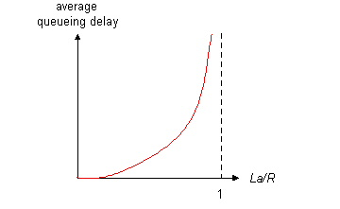
A note on Queueing delay
R=link bandwidth (bps)
L=packet length (bits)
a=average packet arrival rate
traffic intensity = La/R
La/R ~ 0: average queueing delay small
La/R -> 1: delays become large
La/R > 1: more “work” arriving than can be serviced, average delay infinite!

Slide 20
Total delay
d_{total} = d_{nodalproc}+ d_{queue}+ d_{trans}+ d_{prop}
d_{nodalproc} = processing delay in the node (router)
typically a few microsecs or less
d_{queue} = queuing delay
depends on congestion
d_{trans} = transmission delay
= L/R, significant for low-speed links
d_{prop} = propagation delay
a few microsecs to hundreds of msecs

Slide 21
“Real” Internet delays and routes
What do “real” Internet delay & loss look like?
Traceroute program: provides delay measurement from source to router along end-end Internet path towards destination. For all i:
sends three packets that will reach router i on path towards destination
router i will return packets to sender
sender times interval between transmission and reply.
3 probes
3 probes
3 probes

Slide 22
Real Internet delays and routes
traceroute: gaia.cs.umass.edu to www.eurecom.fr
Three delay measurements from
gaia.cs.umass.edu to cs-gw.cs.umass.edu
1 cs-gw (128.119.240.254) 1 ms 1 ms 2 ms
2 border1-rt-fa5-1-0.gw.umass.edu (128.119.3.145) 1 ms 1 ms 2 ms
3 cht-vbns.gw.umass.edu (128.119.3.130) 6 ms 5 ms 5 ms
4 jn1-at1-0-0-19.wor.vbns.net (204.147.132.129) 16 ms 11 ms 13 ms
5 jn1-so7-0-0-0.wae.vbns.net (204.147.136.136) 21 ms 18 ms 18 ms
6 abilene-vbns.abilene.ucaid.edu (198.32.11.9) 22 ms 18 ms 22 ms
7 nycm-wash.abilene.ucaid.edu (198.32.8.46) 22 ms 22 ms 22 ms
8 62.40.103.253 (62.40.103.253) 104 ms 109 ms 106 ms
9 de2-1.de1.de.geant.net (62.40.96.129) 109 ms 102 ms 104 ms
10 de.fr1.fr.geant.net (62.40.96.50) 113 ms 121 ms 114 ms
11 renater-gw.fr1.fr.geant.net (62.40.103.54) 112 ms 114 ms 112 ms
12 nio-n2.cssi.renater.fr (193.51.206.13) 111 ms 114 ms 116 ms
13 nice.cssi.renater.fr (195.220.98.102) 123 ms 125 ms 124 ms
14 r3t2-nice.cssi.renater.fr (195.220.98.110) 126 ms 126 ms 124 ms
15 eurecom-valbonne.r3t2.ft.net (193.48.50.54) 135 ms 128 ms 133 ms
16 194.214.211.25 (194.214.211.25) 126 ms 128 ms 126 ms
17 * * *
18 * * *
19 fantasia.eurecom.fr (193.55.113.142) 132 ms 128 ms 136 ms
trans-oceanic
link
* means no response (probe lost, router not replying)

Slide 23
Traceroute Command
Man pages will give you the full options that can be used with traceroute
Example below specifies the time to wait ‘w’ for a response before giving up (5secs default), the number of queries ‘q’ to send (3 default), and max number of hops ‘m’ to reach destination (30 default)
traceroute -w 3 -q 1 -m 16 test.com

Slide 24
Jitter
Jitter is: Variation in packet delay
Causes
Variation in packet lengths -> different transmission times
Variation in path lengths -> no fixed paths in the Internet
Jitter is caused by the technology of the Internet
Routers are capacity bound and demand on routers changes rapidly
Some link layers (notably wireless) are shared medium so transmitters will conflict

Slide 25
Jitter
Client A sends at
fixed intervals
Client B receives at
irregular intervals
Sometimes packets
arrive after interval deadline
Sender
Receiver
Notes:
Figure 10.4

Slide 26
Variance of inter-packet arrival times
Correct
spacing
Gaussian distribution
Observed distribution
Frequency of occurrence
Interpacket arrival time

Slide 27
Latency and Jitter : Network Perspective
Regular Timing
Jittered Timing
Sender
Internet
Receiver
Network Latency
Transmission Delay : time it takes to put a packet on the outgoing link
Propagation Delay : time it takes for the packet to arrive at destination

Slide 28
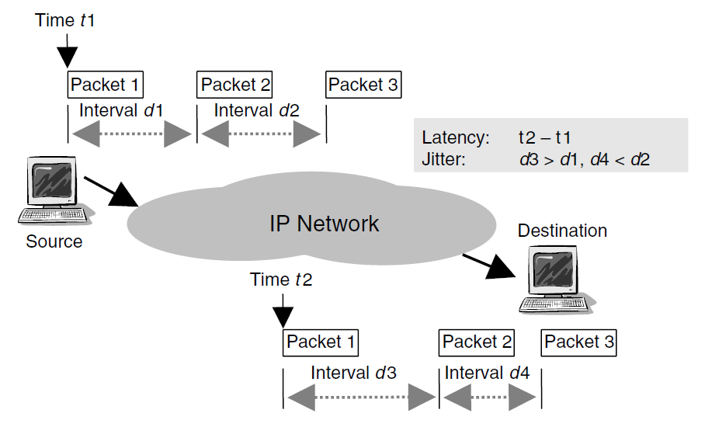
Difference: Jitter and Latency
Latency and Jitter affect streams of packets travelling across the network

Slide 29
Network Latency Estimate
Network Latency Estimate = ((T_{A1} – T_{A0}) - (T_{B1} – T_{B0}))/2
Clock Offset Estimate = (T_{B0} - T_{A0}) – Network Latency Estimate
T_{A0}
T_{B0}
T_{B1}
T_{A1}
Client_{A}
Client_{B}
Notes:
Figure 10.6

Slide 30
Network Jitter Estimate
Sender
T_{S0}
Receiver
T_{S1}
T_{R0}
T_{R1}
Jitter Estimate = (T_{R1} – T_{R0}) - (T_{S1} – T_{S0})
Jitter Moving Average_{i} = a x Jitter Estimate_{i} + (1-a) x Jitter Moving Average_{i-1}
where 0 < a < 1
Notes:
Figure 10.4

Slide 31
Throughput & Loss

Slide 32
Network Bandwidth/Capacity
Bandwidth is a shared resource
At local level we share the wireless or share a home or office router
However probably, the bottleneck is likely to be upstream to our ISP
ISP have intra-ISP bottlenecks
The destination site (BBC, Facebook) might have inbound capacity limits

Slide 33
Loss
Another GOLDEN RULE
Packet Loss is a Good Thing
It is the Internet’s defence against failure
Dropping packets (hopefully) causes senders
(processes or users) to rate-limit

Slide 34
Loss : Network Perspective
Input Queues
Output Queues
Loss
Routing Table
Handler
Notes:
Queue is full, packet is dropped

Slide 35
Packet loss
queue (aka buffer) preceding link has finite capacity
packet arriving to full queue dropped (aka lost)
lost packet may be retransmitted by previous node, by source end system, or not at all
buffer
(waiting area)
packet being transmitted
A
B
packet arriving to
full buffer is lost

Slide 36
Throughput : Network Perspective
Throughput : number of bits per time of unit

Slide 37
Throughput : Network Perspective
Throughput : number of bits per time of unit
Potential Loss and Increased Delay

Slide 38
Throughput
throughput: rate (bits/time unit) at which bits transferred between sender/receiver
instantaneous: rate at given point in time
average: rate over longer period of time
link capacity
R_{s} bits/sec
link capacity
R_{c} bits/sec
server, with
file of F bits
to send to client
pipe that can carry
fluid at rate
R_{s} bits/sec)
pipe that can carry
fluid at rate
R_{c} bits/sec)
server sends bits
(fluid) into pipe

Slide 39
Throughput (more)
R_{s} < R_{c} What is average end-end throughput?
R_{s} bits/sec
R_{c} bits/sec
R_{s} > R_{c} What is average end-end throughput?
R_{s} bits/sec
R_{c} bits/sec
bottleneck link
link on end-2-end path that constrains end-2-end throughput, i.e., the smallest/narrowest link

Slide 40
STATE OF THE INTERNET

Slide 41
Bandwidth and Latency: Wired
Broadband is now common in homes
500Kbps – 1Gbps
Depends on technology (twisted-pair v. optical)
Offices have always been different
1Gbps Ethernet, switched (not shared) is common
Outbound varies enormously
Low Latency

Slide 42
Bandwidth and Latency: Wireless
2G
Don’t try, run web or sms-based applications!
3G / 4G
3G: ~2.4Mbps
4G: 100Mbps – 1Gbps
802.11a-n, ac
b: 11 Mbps
g: 54 Mbps
n: 74 Mbps
ac: 150Mbps
Latency is moderate-poor: its shared bandwidth

Slide 43
Effect of distance on throughput and download times
Based on (Leighton, 2009)

Slide 44




